Slide 1


May Webinar
Clear The Air: A Conversation with NWI Partners for Clean Air
Featuring:
Kathy Luther (NIRPC)
Scott Nelson (Cheneco Energy)

Slide 2


OVERVIEW
KATHY LUTHER
PARTNERS FOR CLEAN AIR
TREASURER
NIRPC
DIRECTOR OF ENVIRONMENTAL PROGRAMS
SCOTT NELSON
PARTNERS FOR CLEAN AIR
A DVI S O R Y BO A R D C H A I R
S CH OL A R S H I P C OM M I T TE E CH A I R
CHENECO
VP BU S I N E S S DE VE LO PM E N T

Slide 3
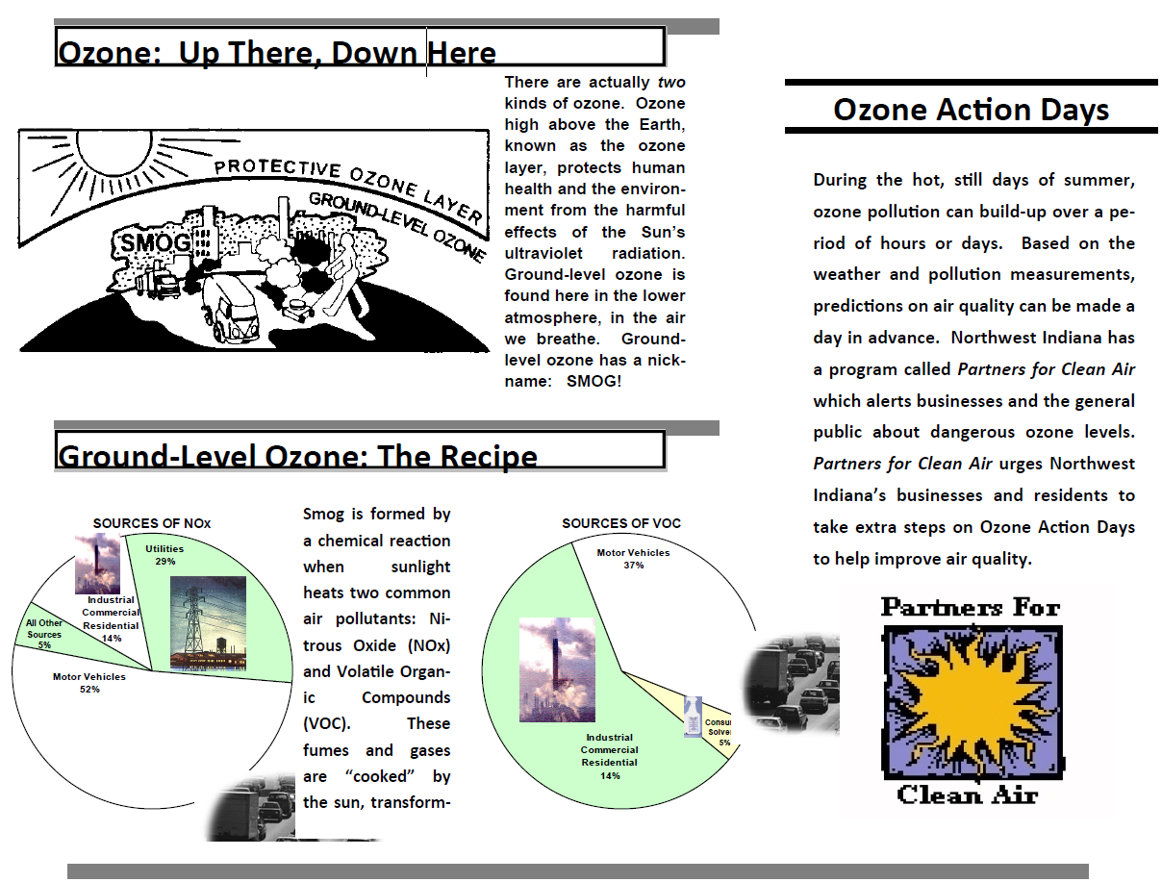
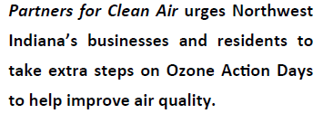
History
Partners for Clean Air
1999
Origins
Clean Air Act Amendments of 1990
Numerous voluntary partnerships were initiated at the federal, state, and regional level
  Indiana-MACOG 1994
  Illinois-Chicago 1996
  Indiana-NW 1998
Notes:
voluntary partnership programs help businesses, the public and governments take actions that reduce emissions of greenhouse gas and conventional air pollutants, and protect people from exposure to pollution-caused harm. Many of these programs have additional benefits such as improving energy efficiency, reducing oil imports, and saving consumers money.
In 1998 NIRPC produced an air quality video and initiated a 3 year air quality public awareness campaign using Congestion Mitigation and Air Quality Funding. IDEM agreed to allow NIRPC to solicit members for Partners for Clean Air for the initiative.
Presented at Rotary Clubs

Slide 4
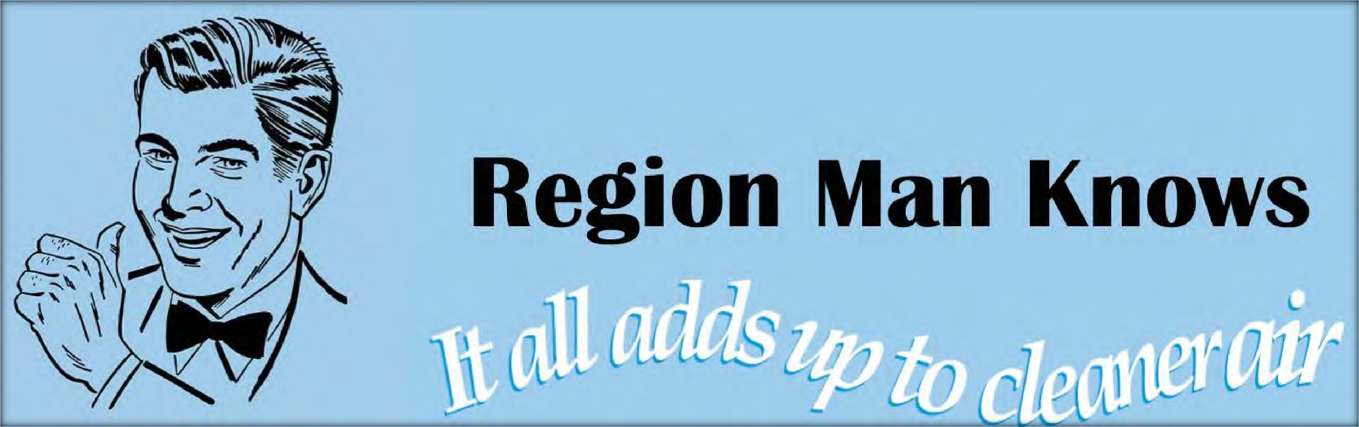
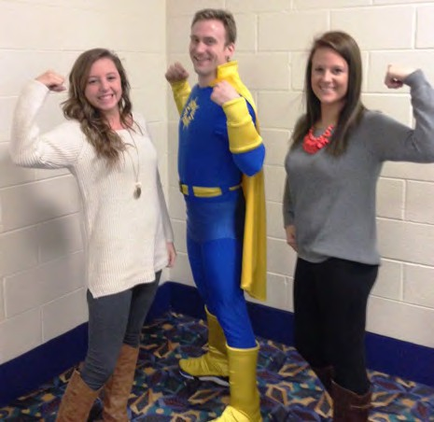
1999
NIRPC - 1 of 14 Communities
" I t All Adds Up To Cleaner Air
HISTORY
U.S. E P A
Federal Highway Administration
Federal Transit Administration

Slide 5

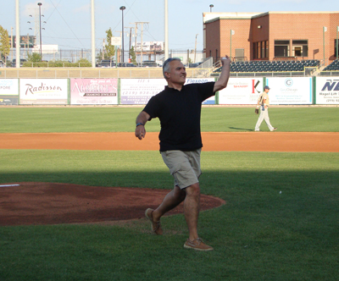
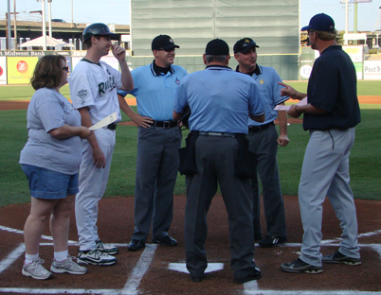
HISTORY
ASTHMA AWARENESS 2004- 2012
Air Quality Awareness 2013 - 2025
20 YEARS OF RAILCATS PARTNERSHIP
Notes:
PARTNERSHIP WITH THE RAILCATS
BEGAN WITH ASTHMA AWARENESS DAY – NIRPC, Methodist Hospital, PCA, Businesses

Slide 6
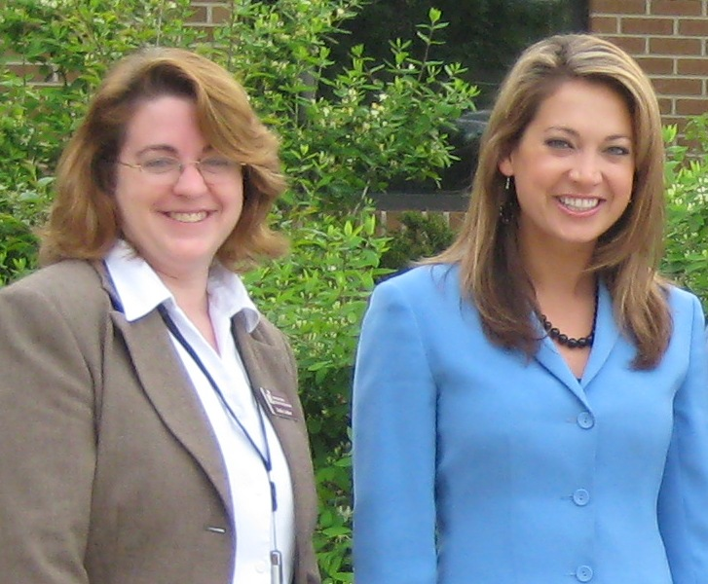
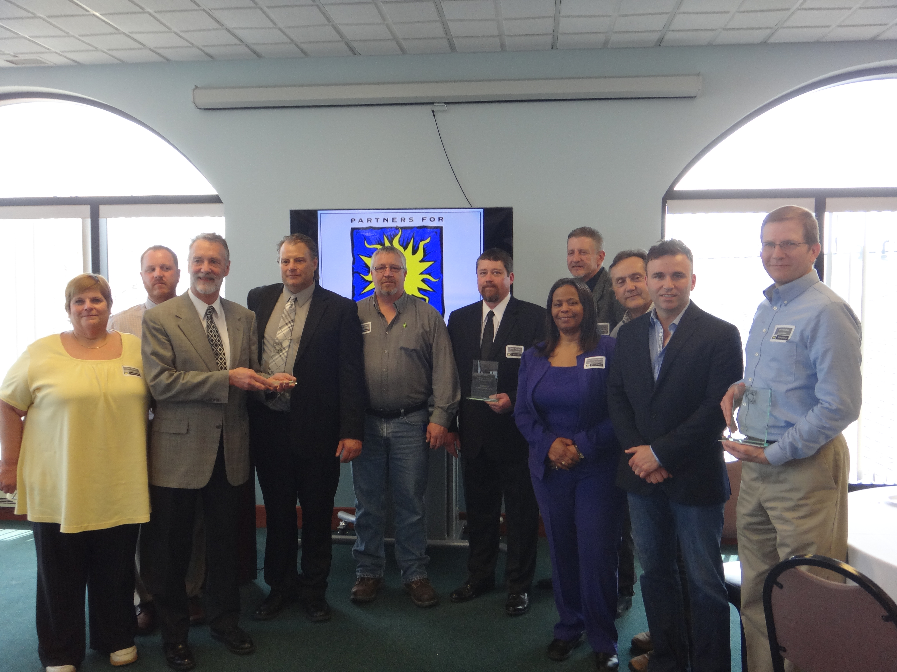
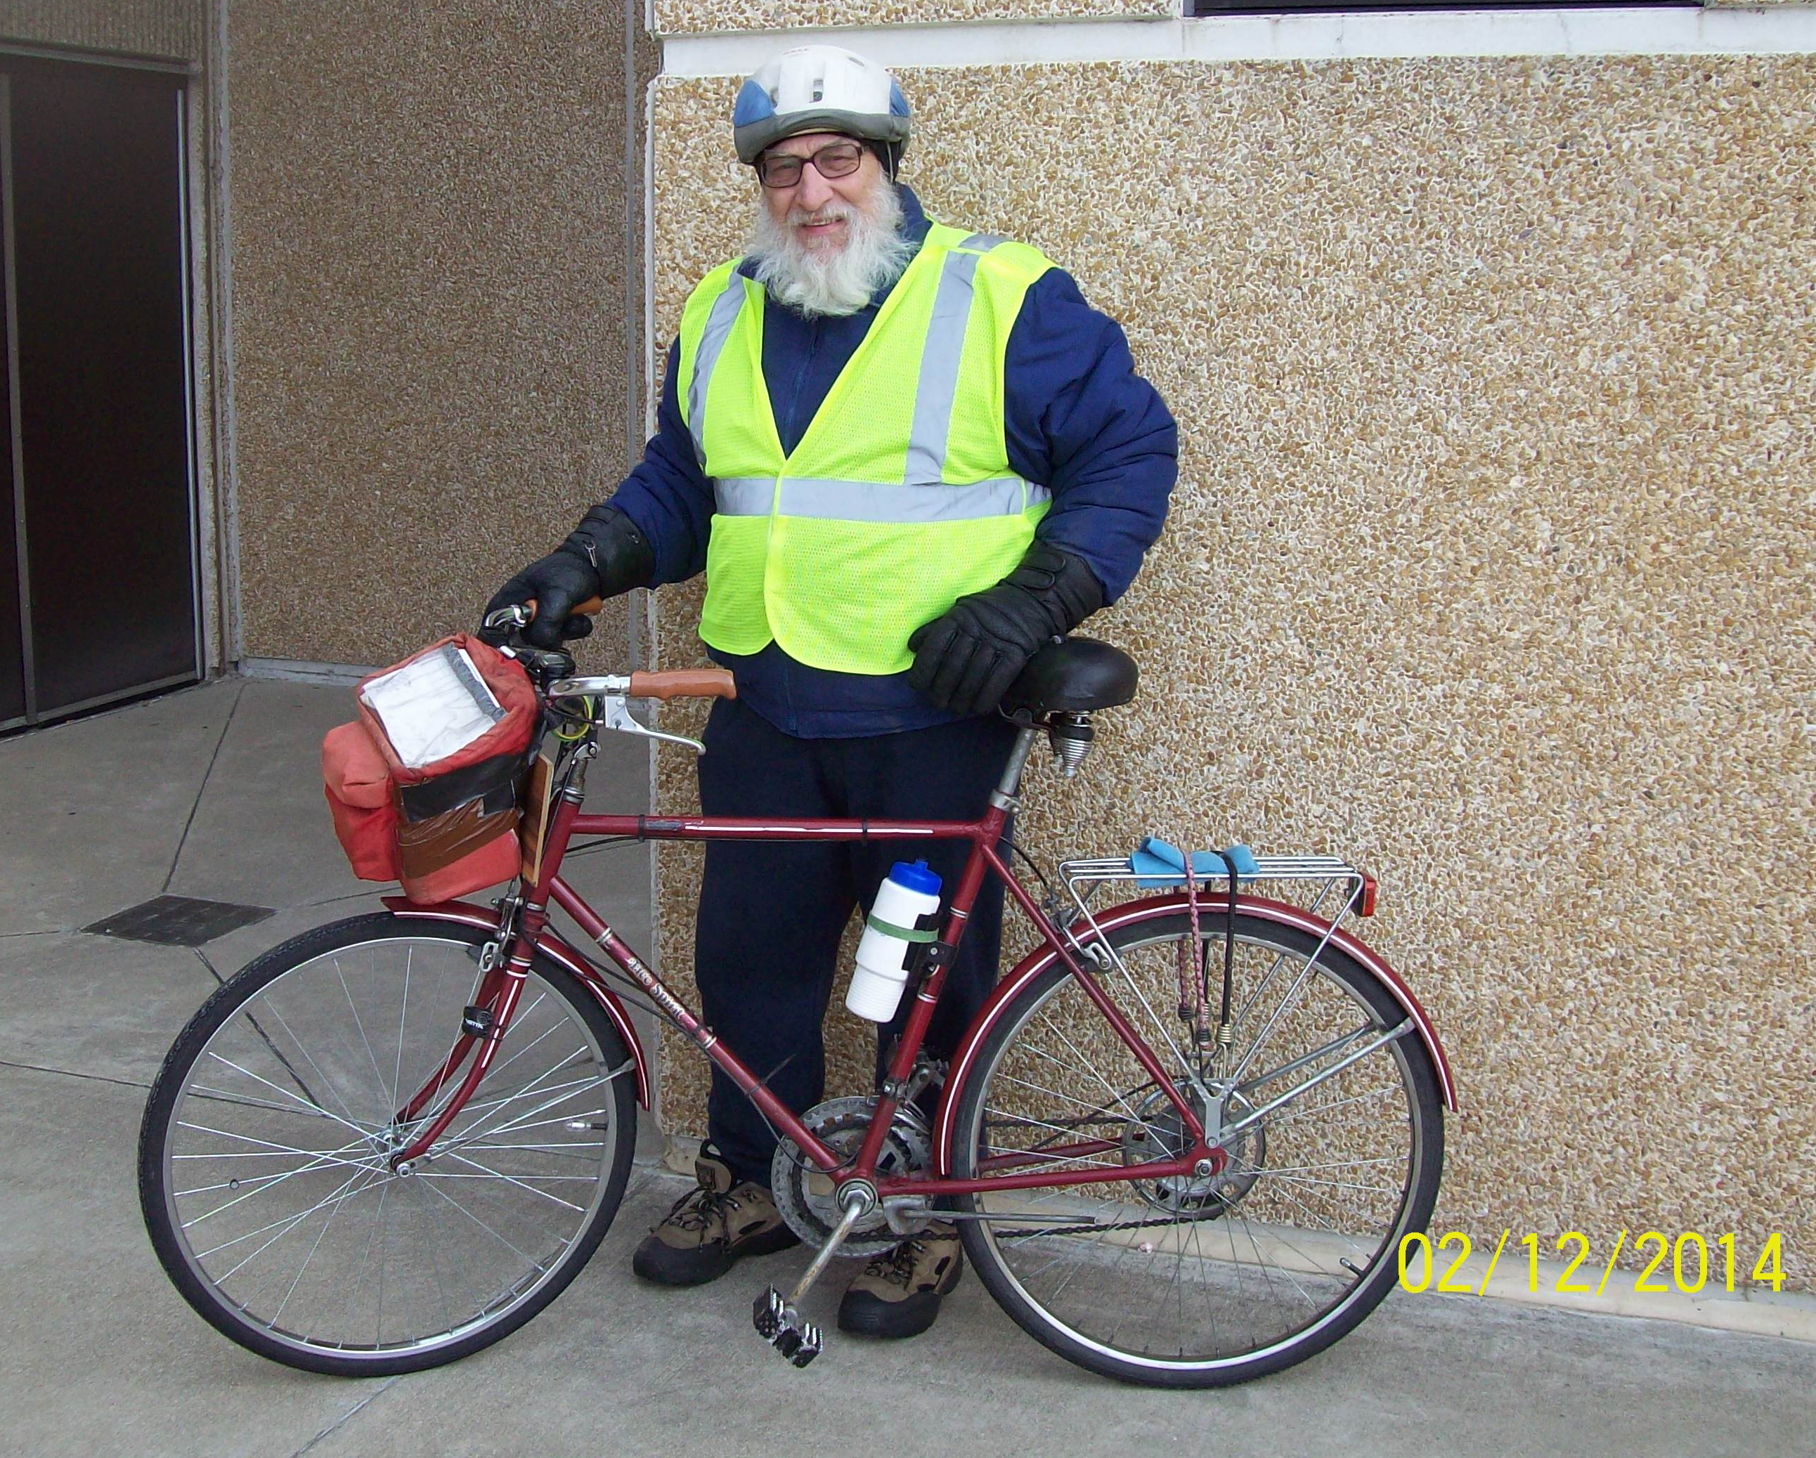
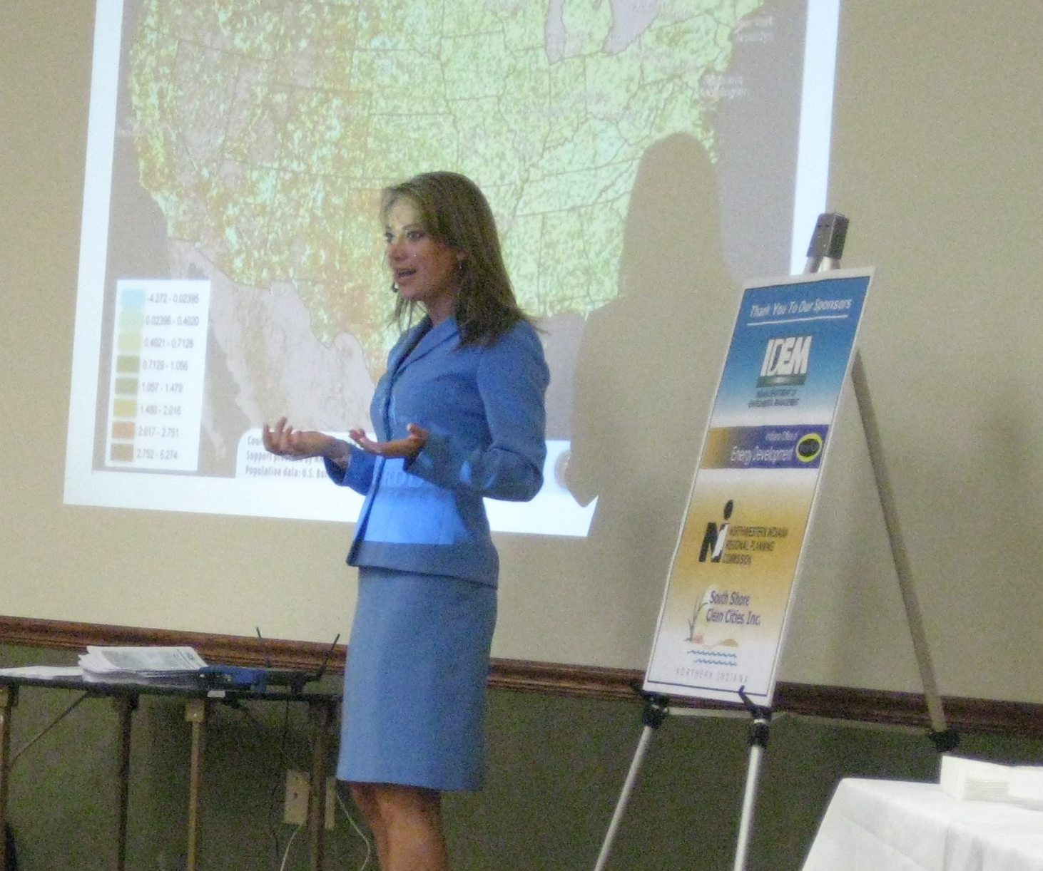
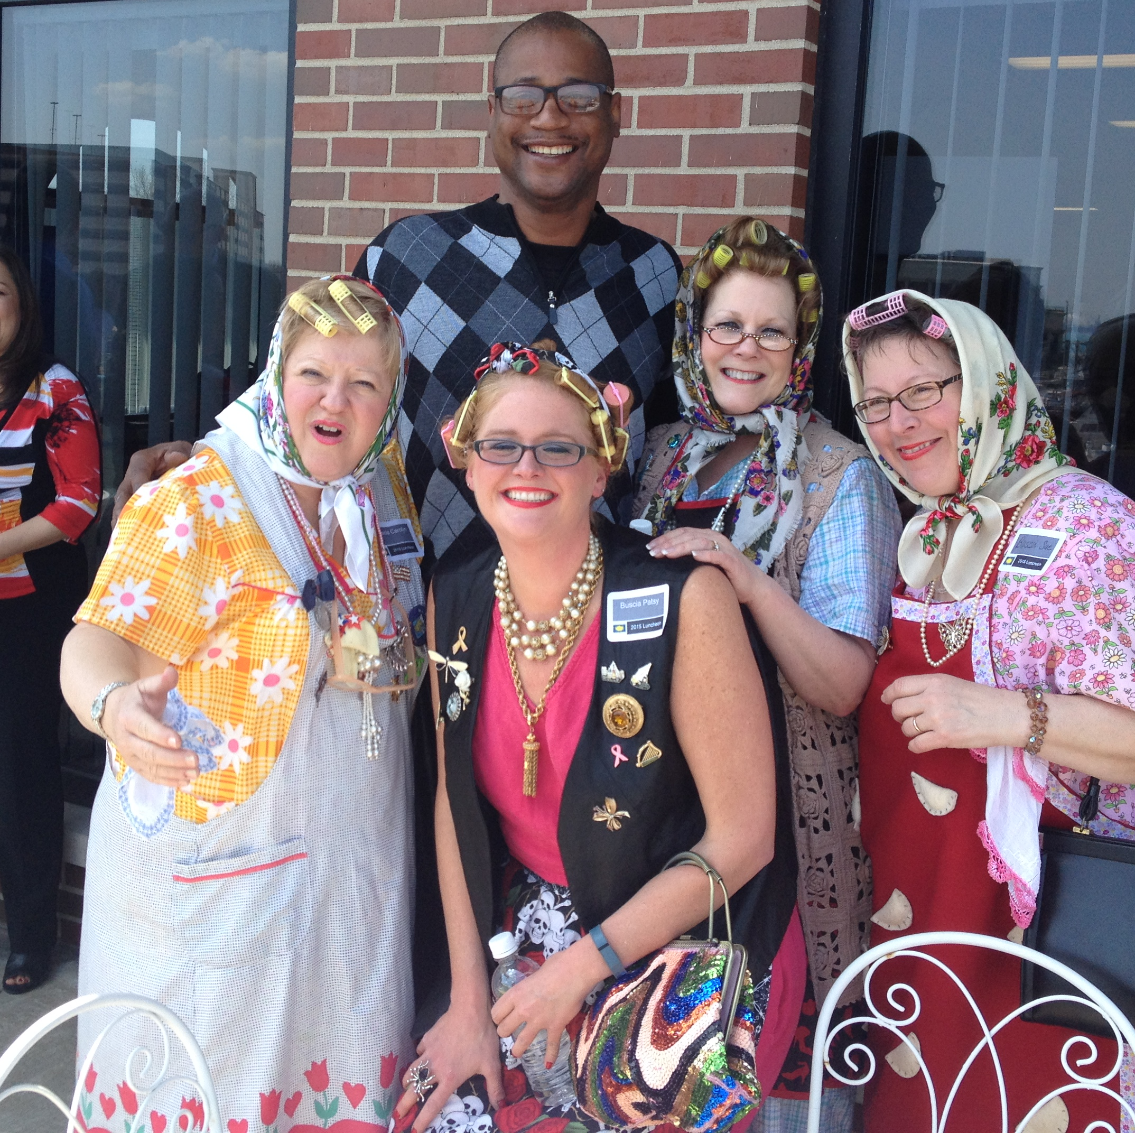
History
Partners for Clean Air Awards
Breakfasts
Lunches
Celebrities
Commissions
Governments
Businesses
Bike Supporters
Notes:
From Breakfasts at NIRPC to Lunches at the Hammond Marina,
From Celebrity Guest Speakers and to Babushka Ladies

Slide 7
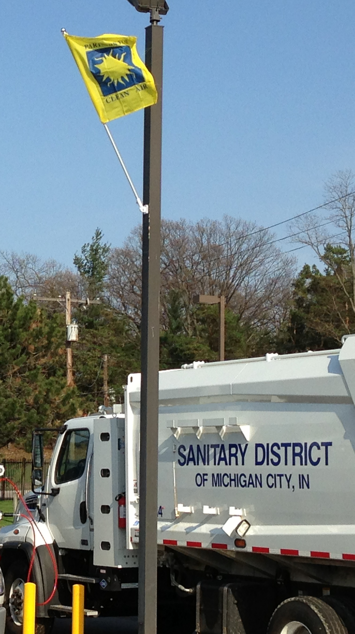
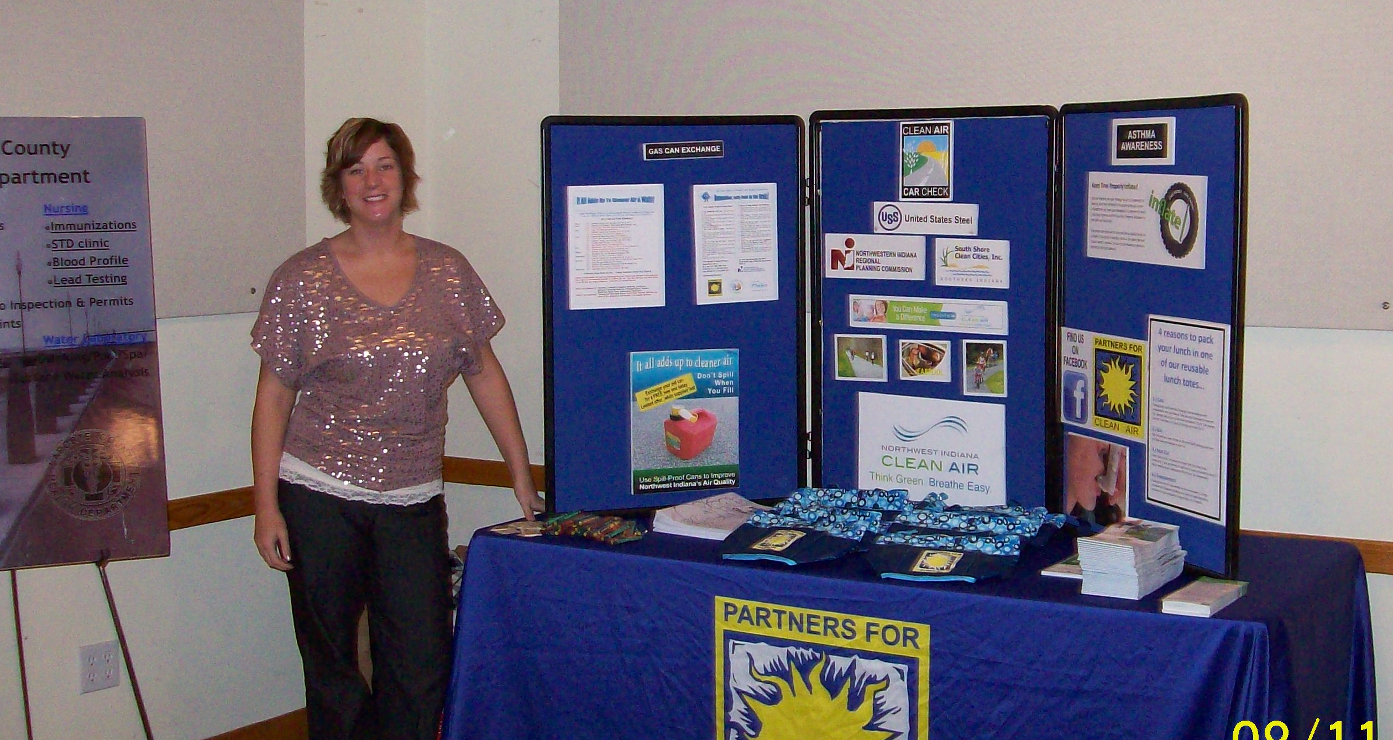

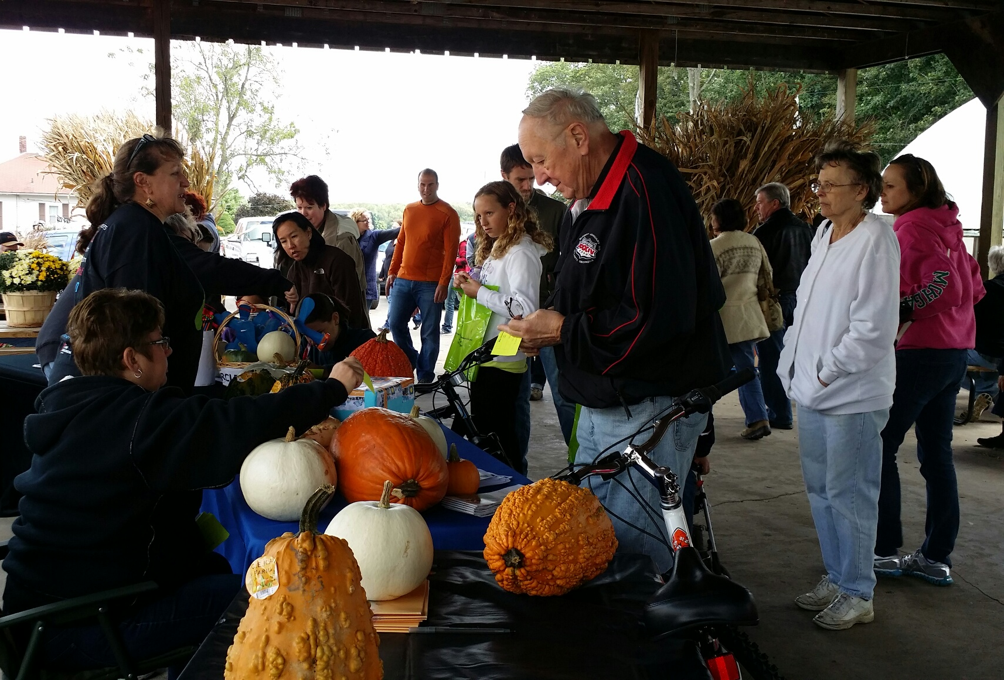
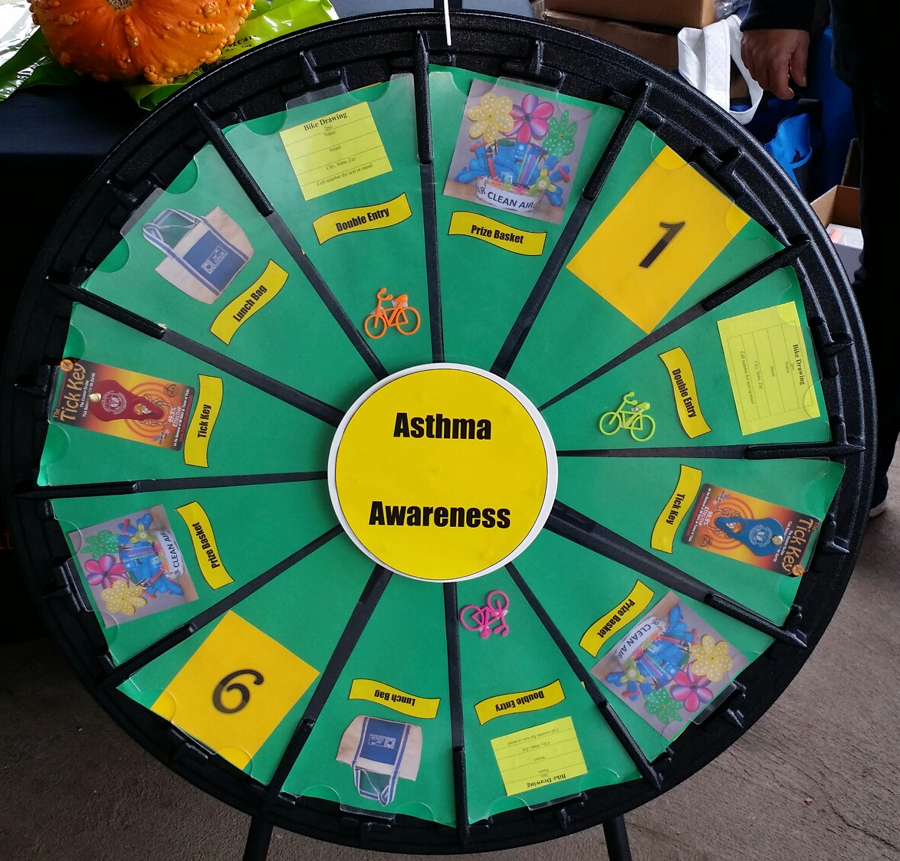
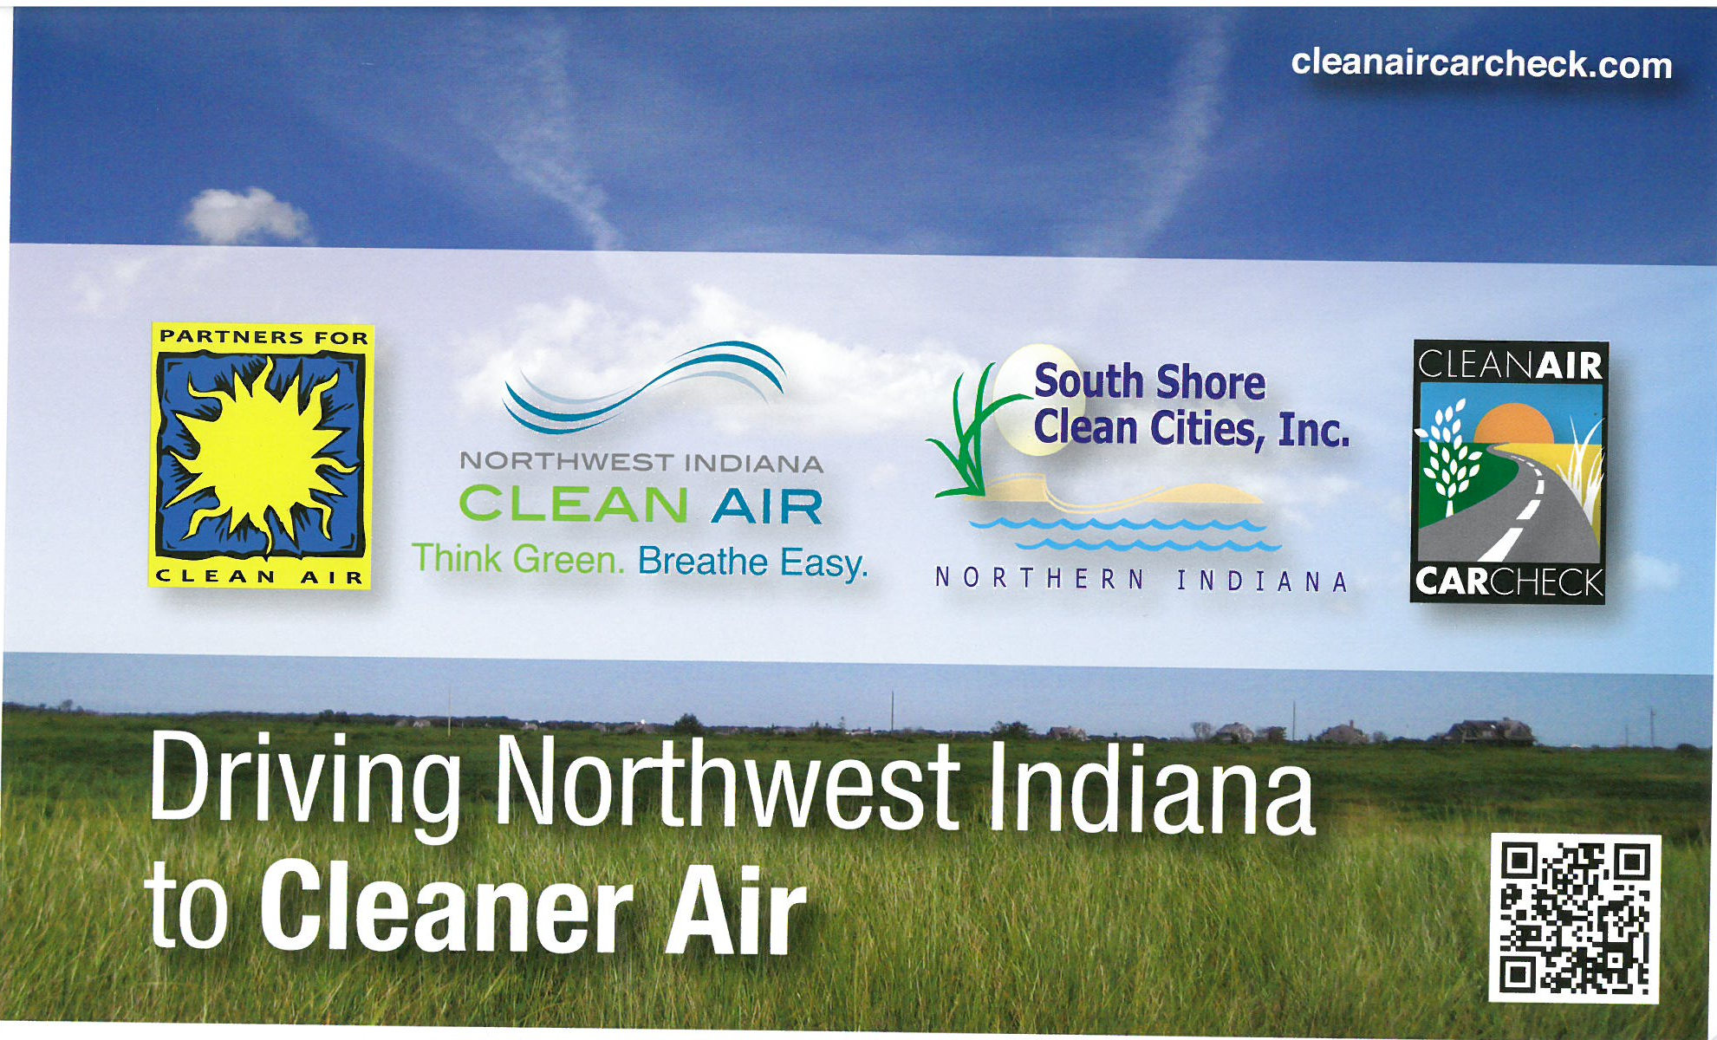

Slide 8
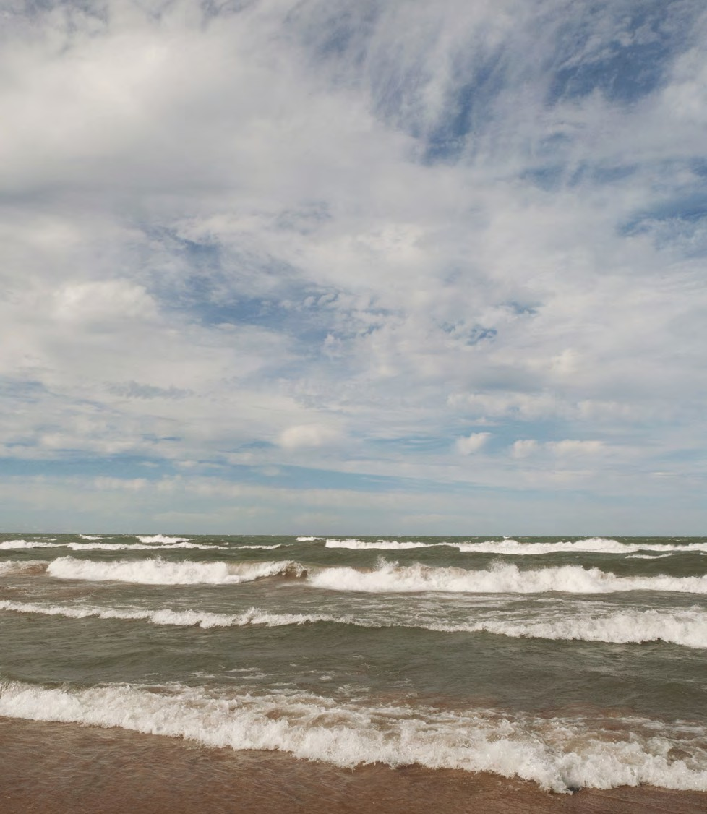
Mission
3
Partners for Clean Air is a coalition of Indiana businesses, industries, municipal entities, community groups, and individuals that are committed to improving air quality and public health through voluntary actions in Northwest Indiana.
The goal of the coalition is to educate our members and the public about the importance of air quality and what we can do to help reduce ground-level ozone and particulate matter in our communities.
Confidential Copyright ©
3

Slide 9
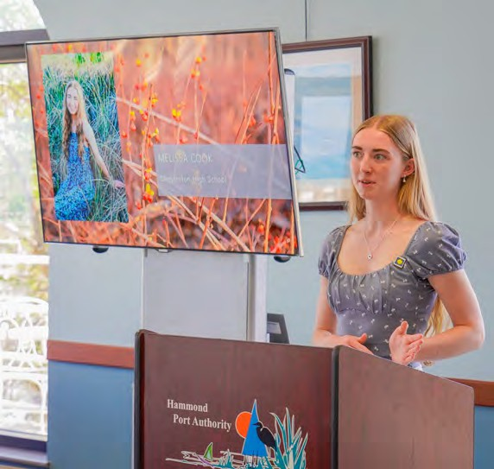
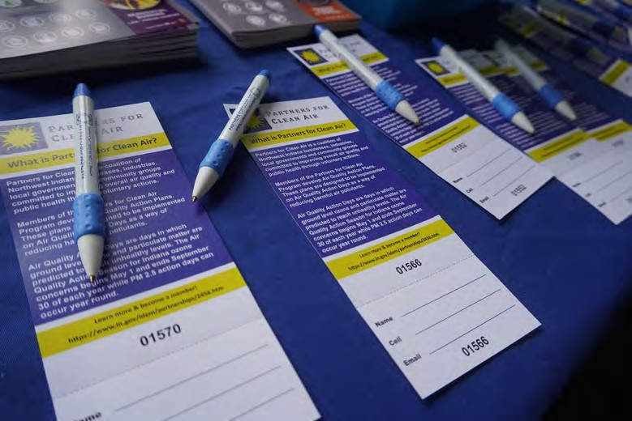

Initiatives
4
Scholarships
Education
Outreach
Confidential Copyright ©

Slide 10
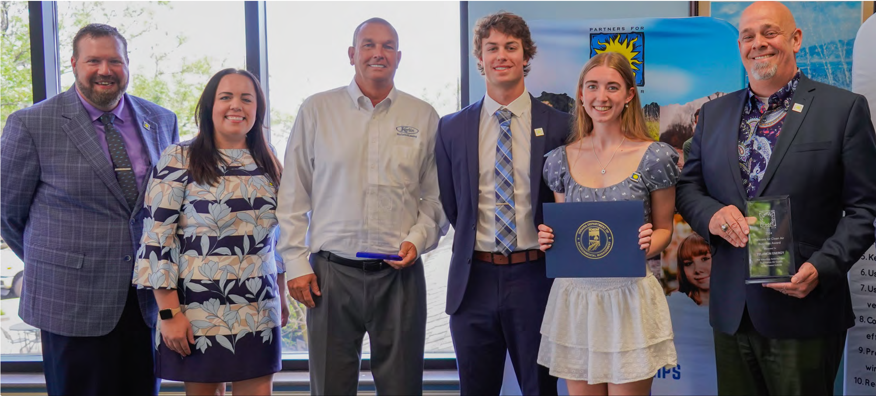
Scholarships
5
Annual scholarships awarded for qualifying high school seniors in Lake, Porter and LaPorte counties.
Helping students succeed in post-secondary education goals aligned with clean air and public health.
Applicable to post-secondary education in an associate or bachelor ’s degree program or a trade school certification or degree.
In six years, PCA has awarded $50,000 in scholarships.
Confidential
Copyright ©

Slide 11
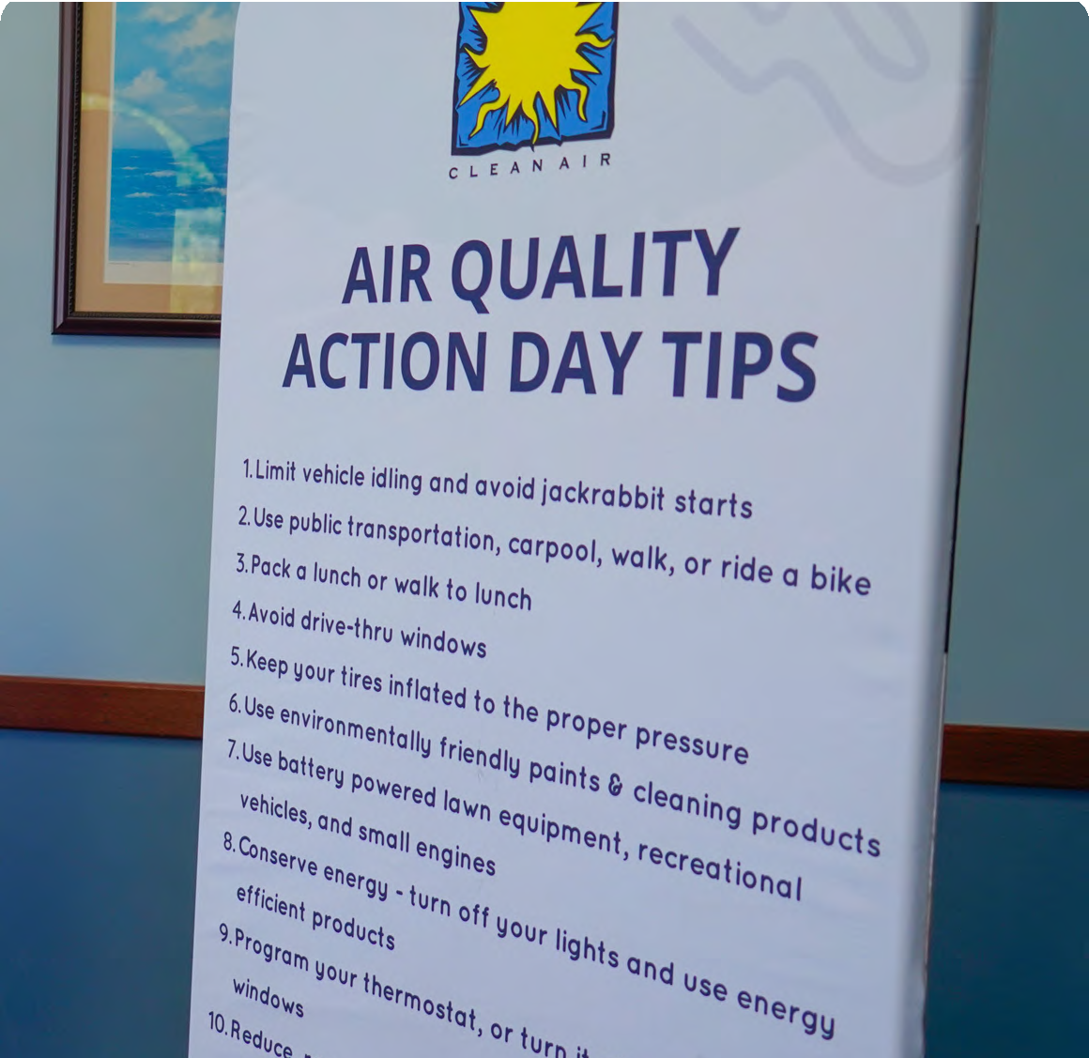
Education
6
Promotion and implementation of air quality improvement actions by our members through energy conservation, emission reduction measures and organizational policies and incentives.
Dissemination of air quality action day alerts through our coalition members.
Promotion of air quality action day tips to help reduce ground-level ozone and particulate matter.
Coverage of air quality initiatives, member programs, scientific developments and trainings via the PCA quarterly newsletter.
Confidential Copyright ©

Slide 12
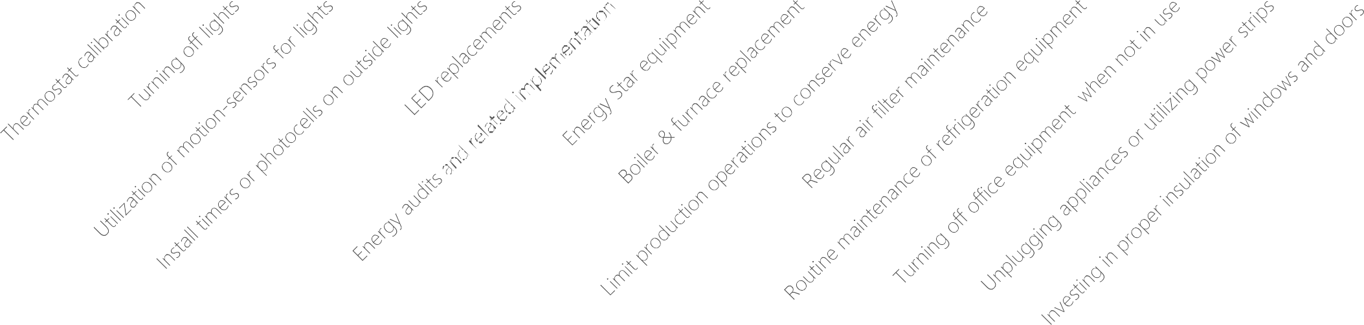
7
Energy Conservation
14
12
10
8
6
4
2
0
Confidential Copyright ©

Slide 13
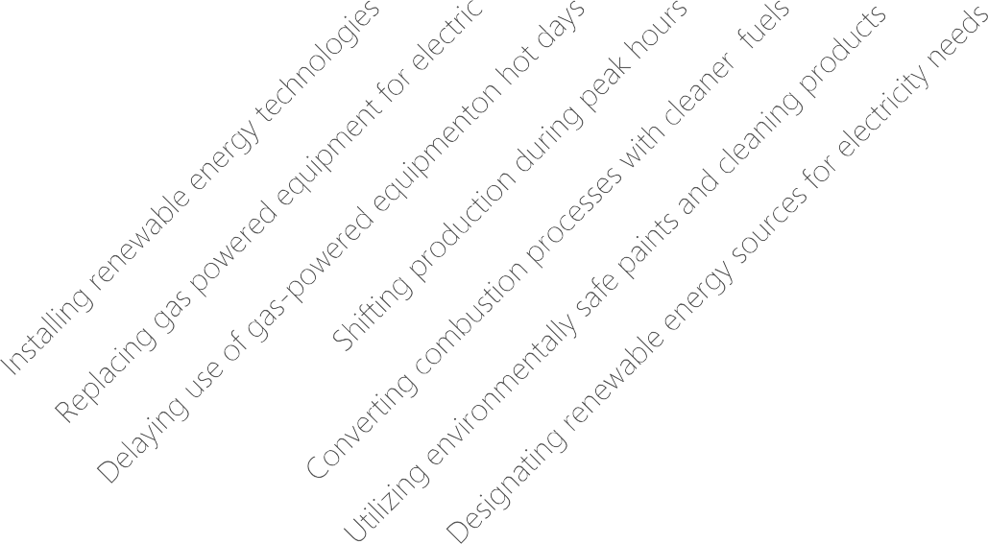
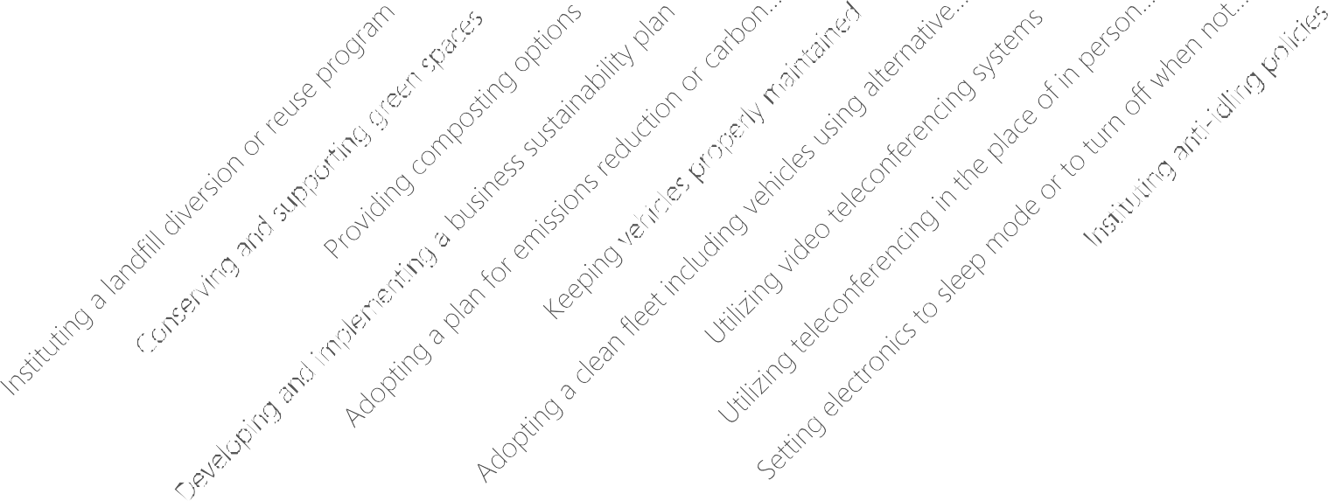
8
Emissions Reductions
14
12
10
8
6
4
2
0
Confidential Copyright ©

Slide 14
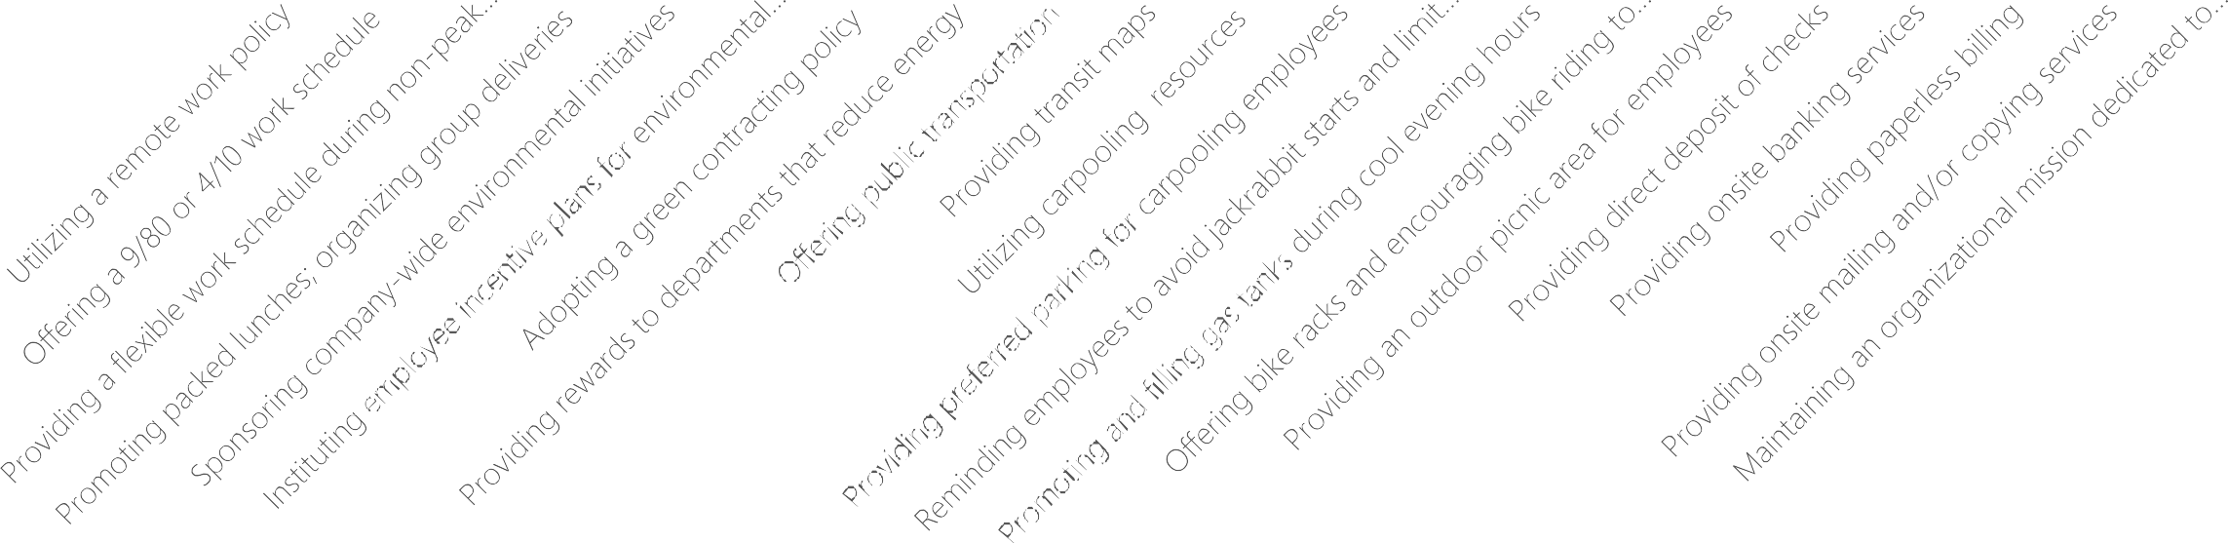
9
Organizational Policies & Incentives
14
12
10
8
6
4
2
0
Confidential Copyright ©

Slide 15
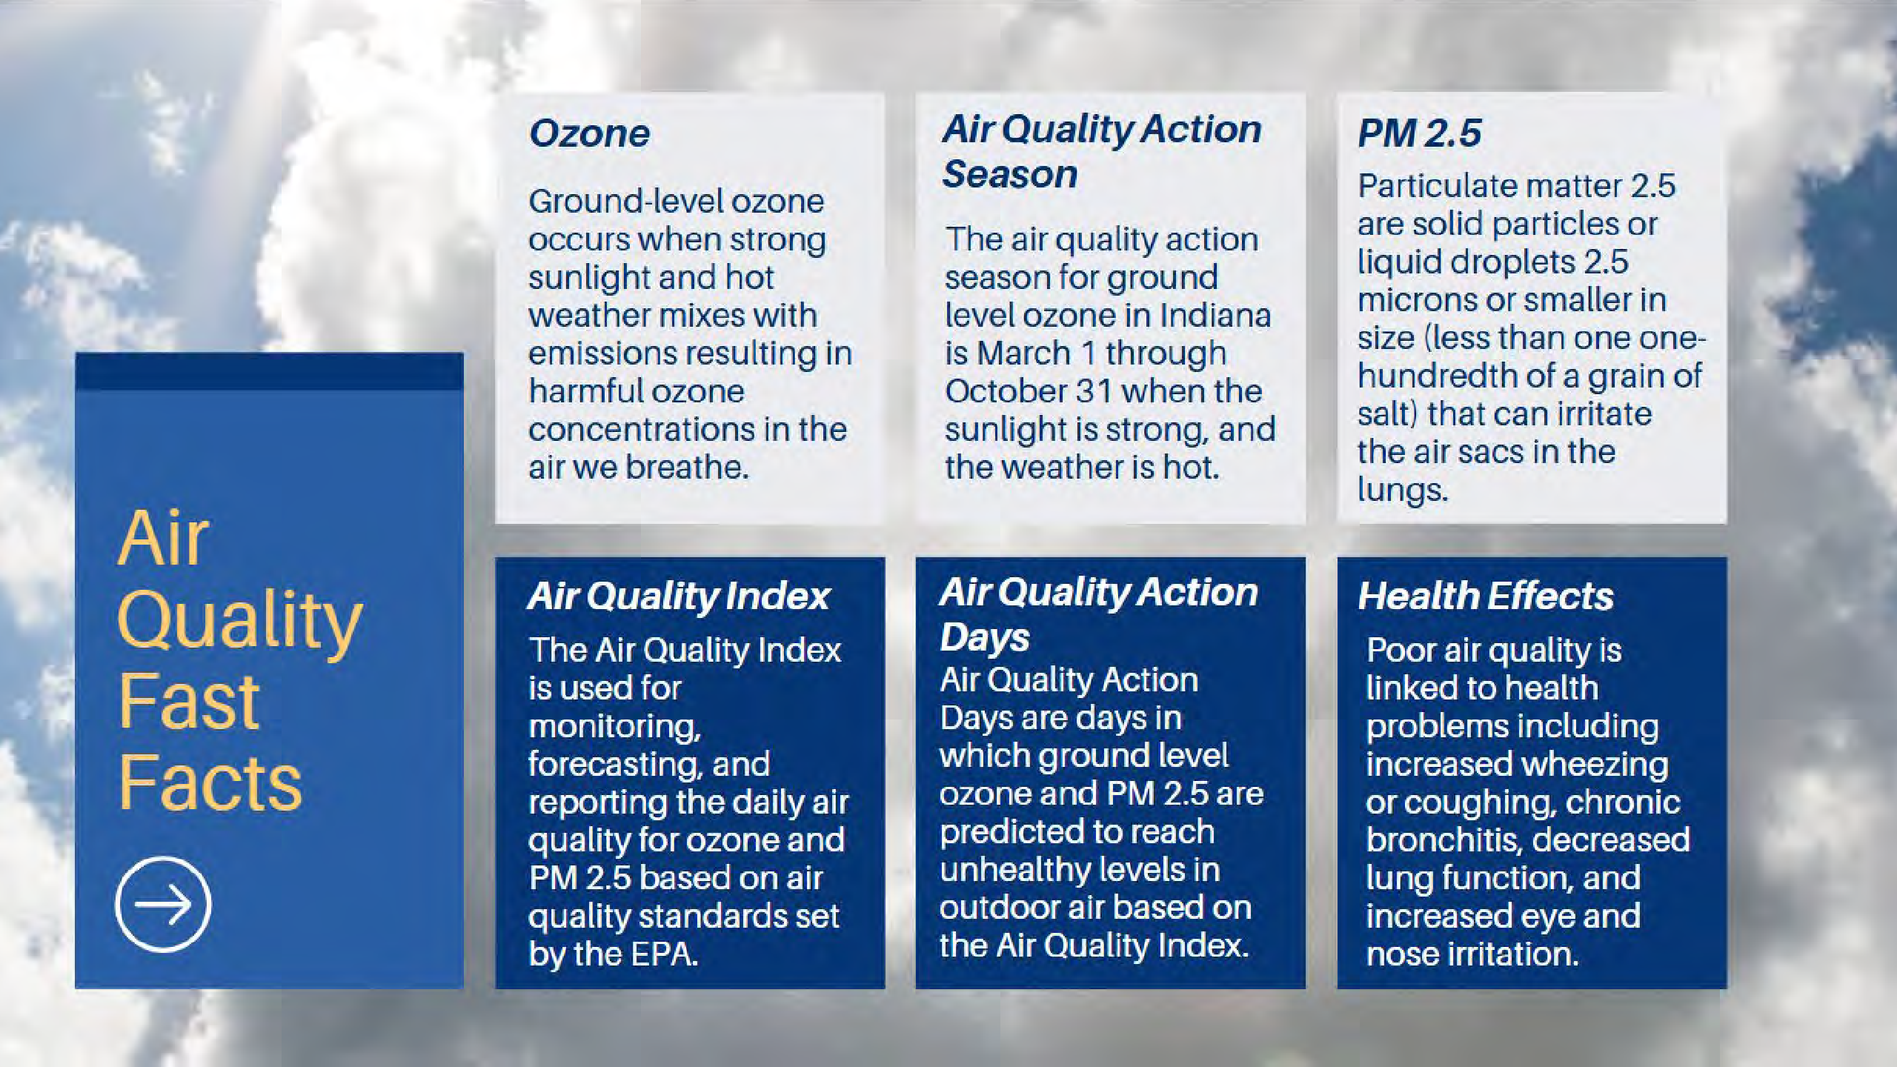

Slide 16
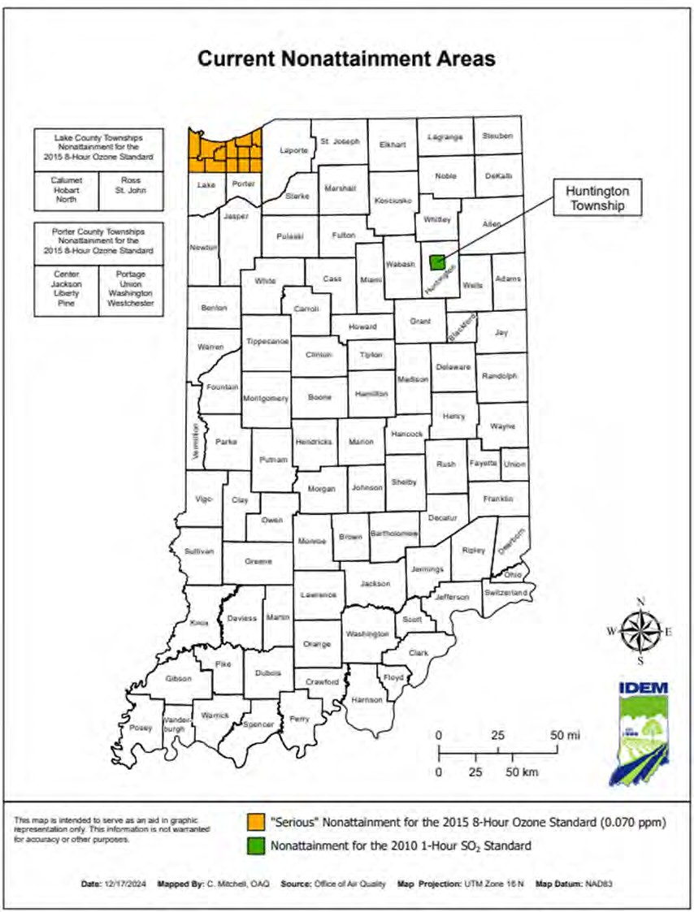
11
The Clean Air Act requires the United States Environmental Protection Agency (U.S. EPA) to set National Ambient Air Quality Standards (NAAQS) for pollutants that cause or contribute to air pollution which may reasonably be anticipated to endanger public health and welfare. The U.S. EPA has set NAAQS for the six criteria pollutants: carbon monoxide (CO), lead (Pb), nitrogen dioxide (NO2), ozone (O3), particulate matter (PM), and sulfur dioxide (SO2).
Nonattainment areas are designated regions within the country where measured concentrations of one or more criteria pollutant exceeds the NAAQS or contribute significant amounts of pollutants to an area that measures air quality that exceeds the standard. If a state has nonattainment areas within its borders, the state must submit a state implementation plan (SIP) to
U.S. EPA detailing steps necessary to achieve the standard. Nonattainment areas which are later redesignated to attainment are considered maintenance areas.
Confidential Copyright ©
11

Slide 17






























NORTHWEST INDIANA AIR QUALITY ACTION DAYS
30
AQADs
25
27
20
20
20
15
14
10
12
12
9
10
9
8
7 7
7
7
7
8
5
6
6
4
5
5
5
5
4
2
0
3
1
3
3
0

Slide 18
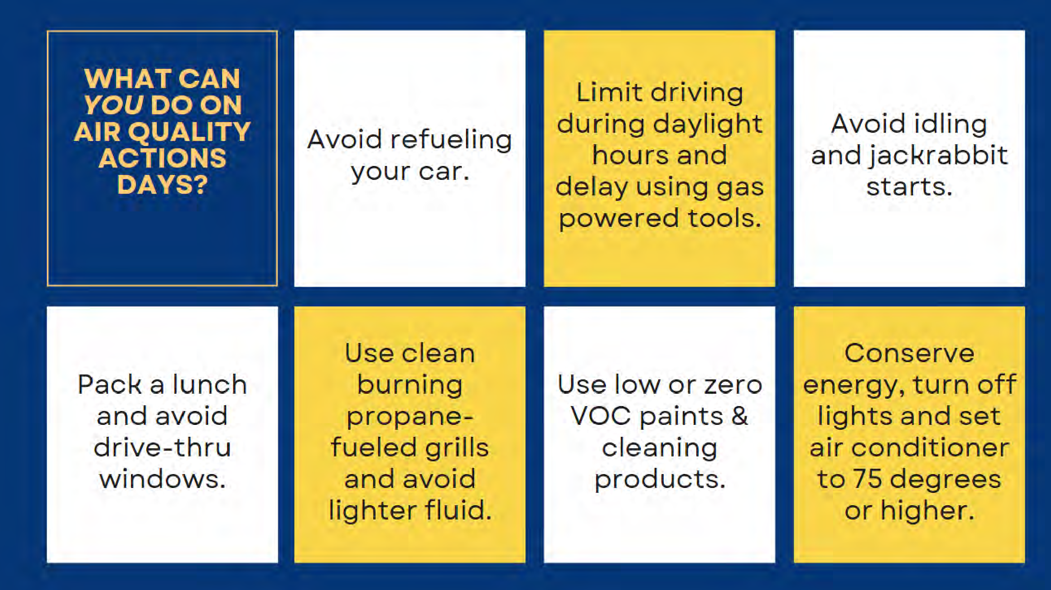

Slide 19


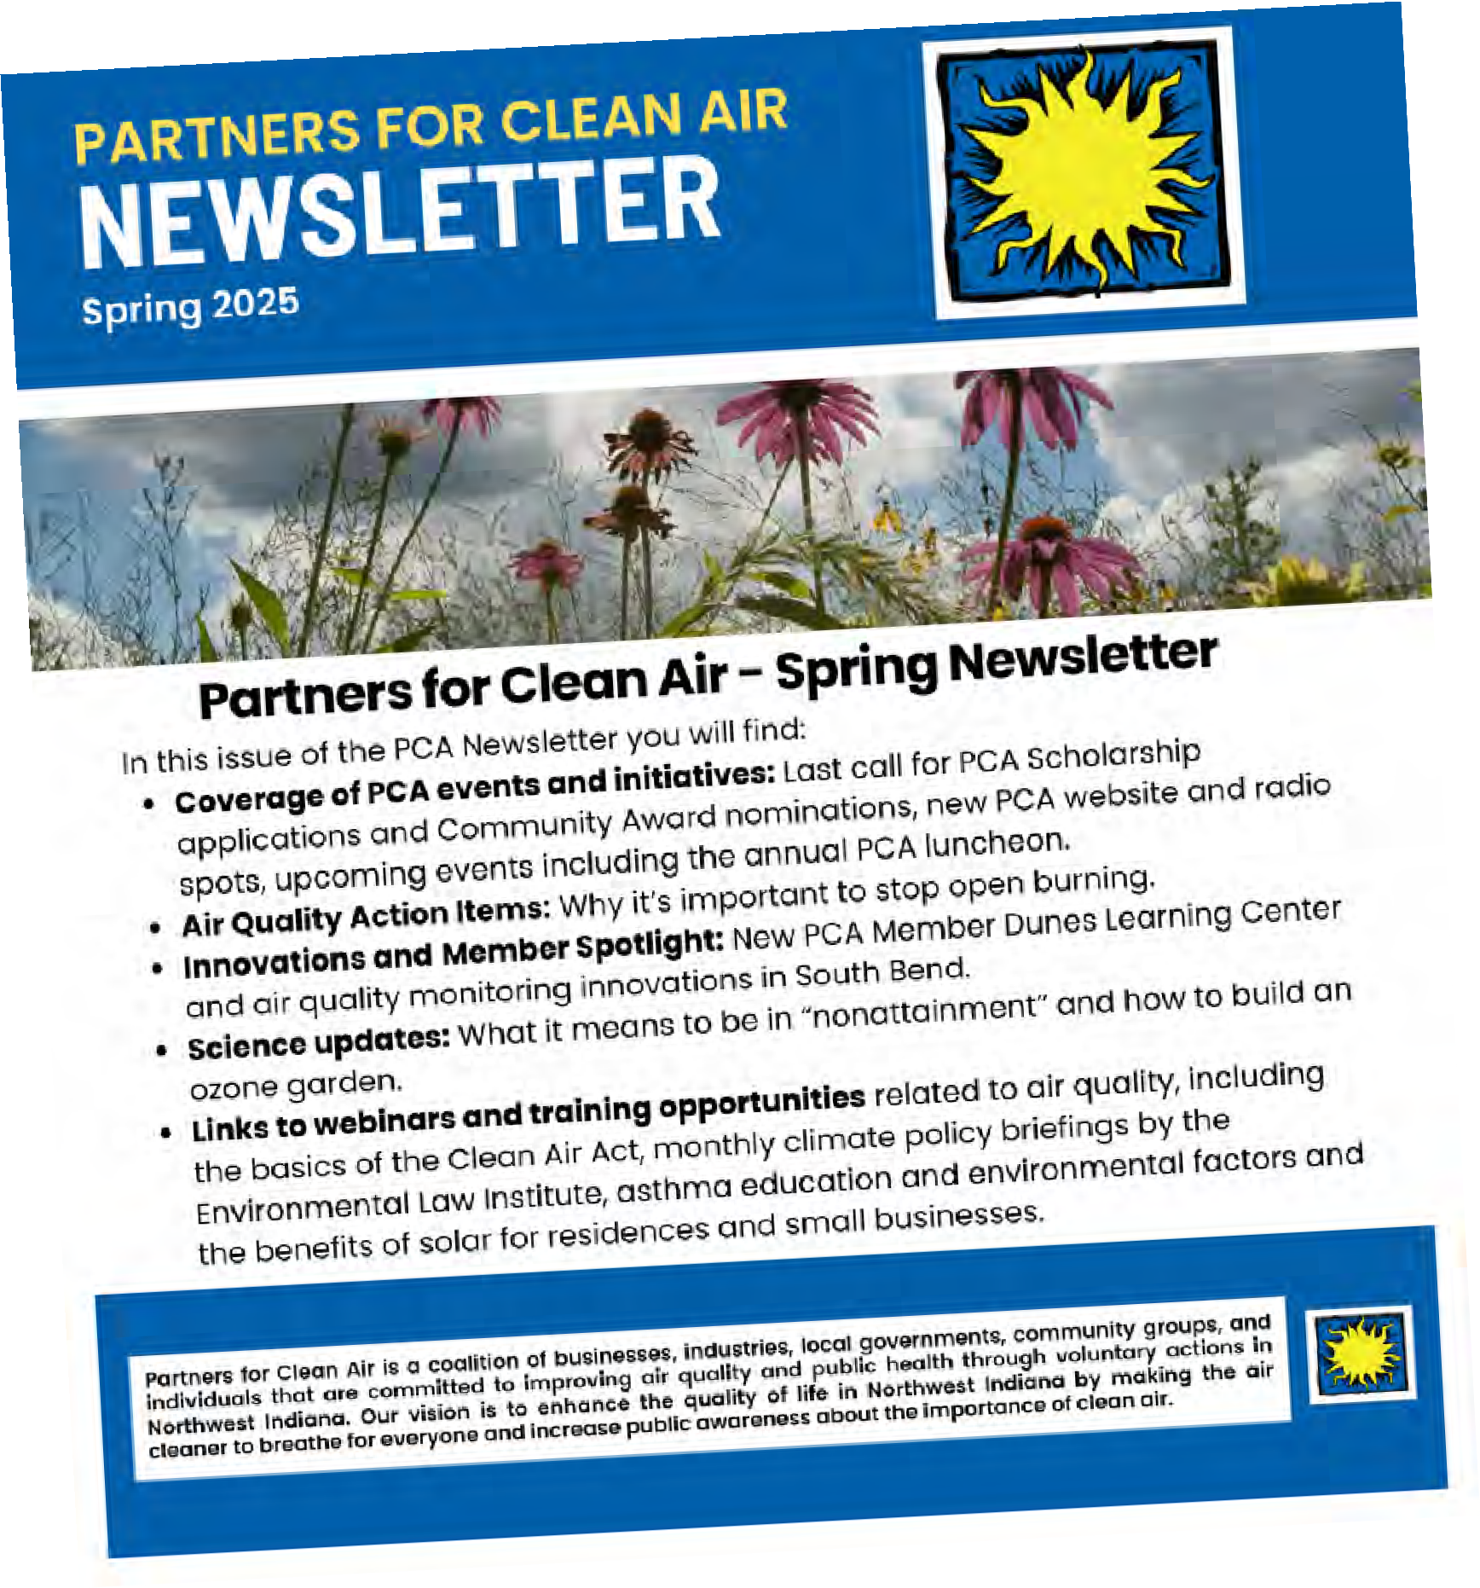
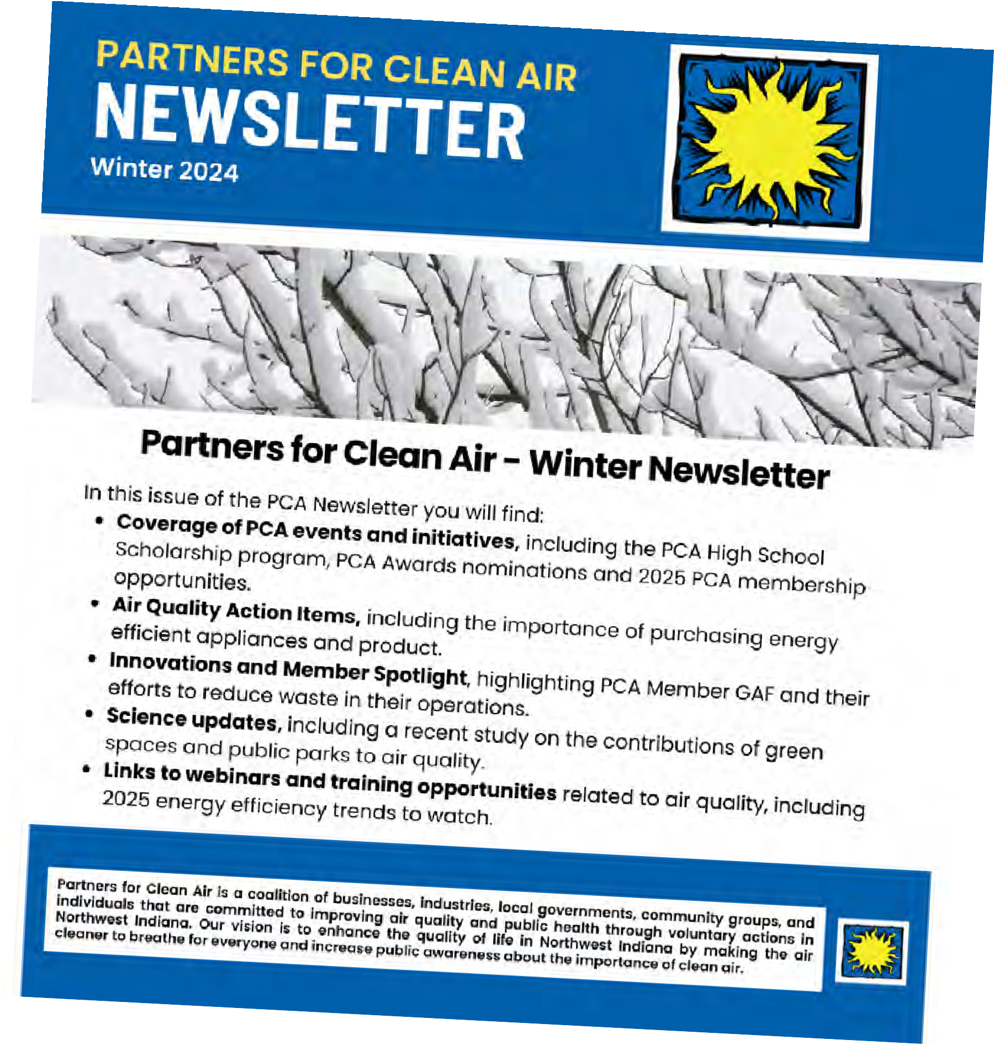

Slide 20
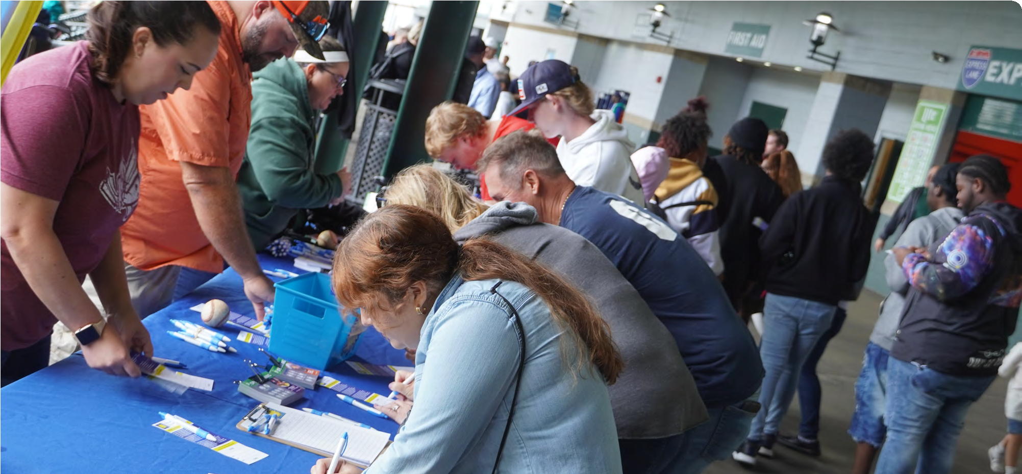
Outreach
16
Regional Earth Day Events
DLC Citizen Science Symposium
PCA Annual Luncheon
Porter County Health Fair
Gary SouthShore RailCats Air Quality Day
Drive Clean Indiana Partnership Events
Urban League Scholarship Fair
PCA Steering Committee Retreat
Adams Radio Group Campaigns
Confidential Copyright ©

Slide 21



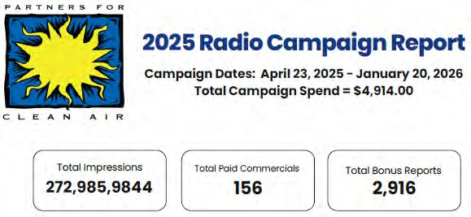
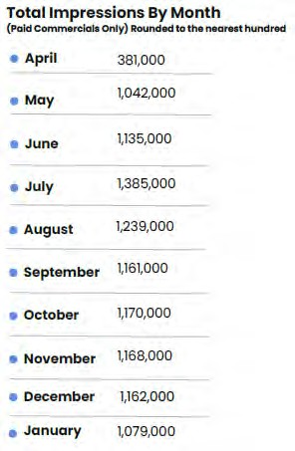
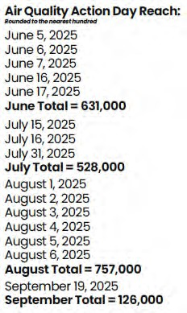
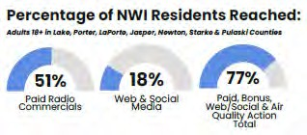
17
Confidential Copyright ©

Slide 22
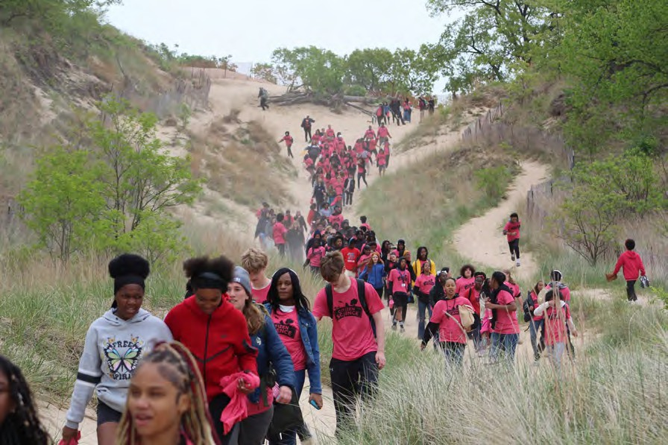
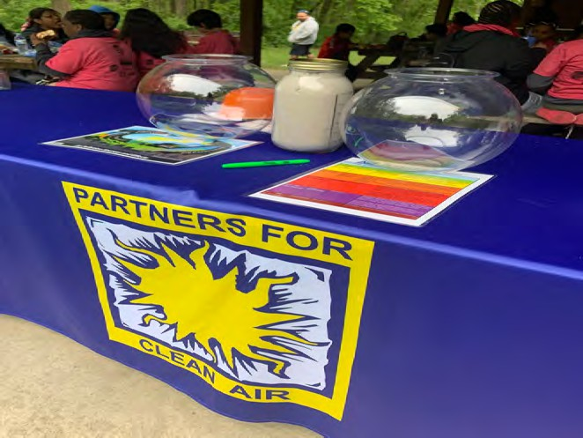
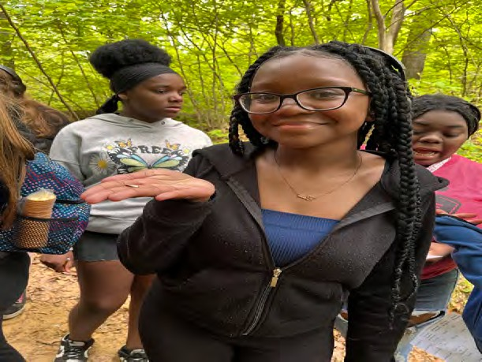

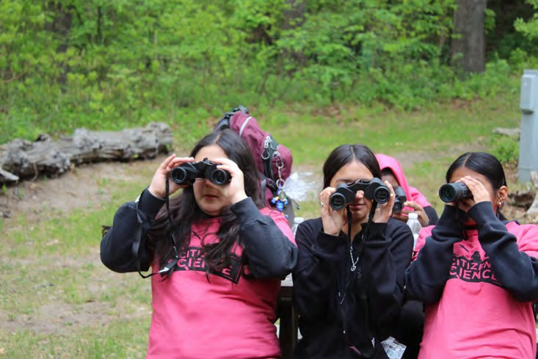
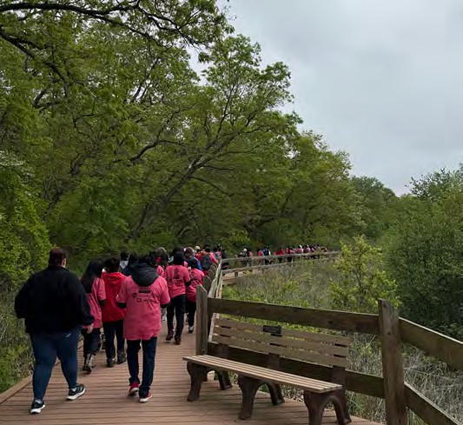
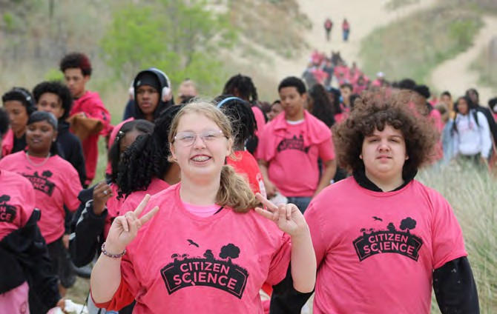
17
Confidential Copyright ©

Slide 23




















Members
19
Adams Radio Group Cheneco
Cleveland Cliffs Drive Clean Indiana
Dunes Learning Center GAF
Gary SouthShore RailCats Hammond Port Authority Homewood Disposal Keramida
LaPorte County Health Department Linde
Lochmueller Group Metro Recycling Nipsco
Northwest Indiana Regional Planning Commission (NIRPC)
NWI Region Resilience NWI Food Council
Porter County Health Department Porter County Parks & Recreation
Porter County Recycling & Waste Reduction Union Township Trustee George Topoll
Union Township Trustee George Topoll
Confidential Copyright ©

Slide 24
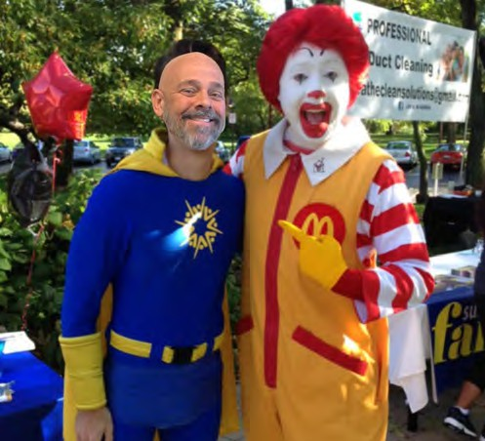
FOR MORE INFORMATION ON NWI PARTNERS FOR CLEAN AIR
WWW.NWIPARTNERSFORCLEANAIR.ORG
19

Slide 25
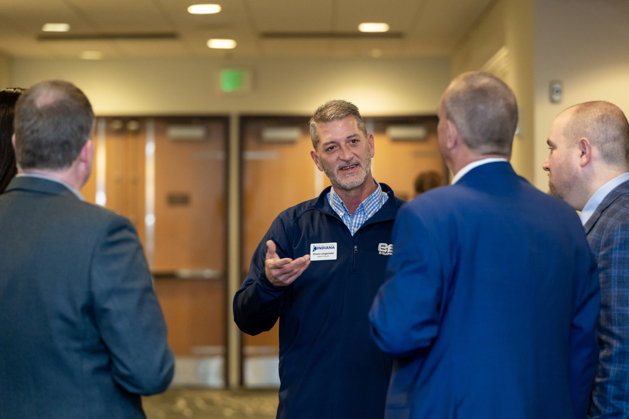
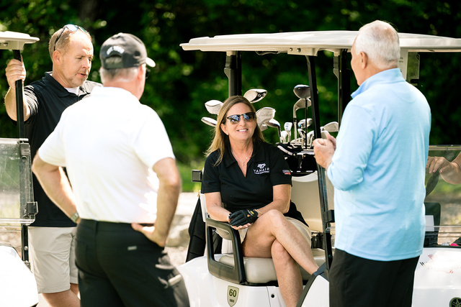
Upcoming DCI Events
  June 11, 2026 - NWI Partners for Clean Air Annual Scholarship & Awards Luncheon
  August 25, 2026 - DCI 14th Annual Clean Air Golf Outing
  November 17-18, 2026 - DCI Crossroads Clean Tech Conference
Visit DriveCleanIndiana.org/events
for more information

Slide 26


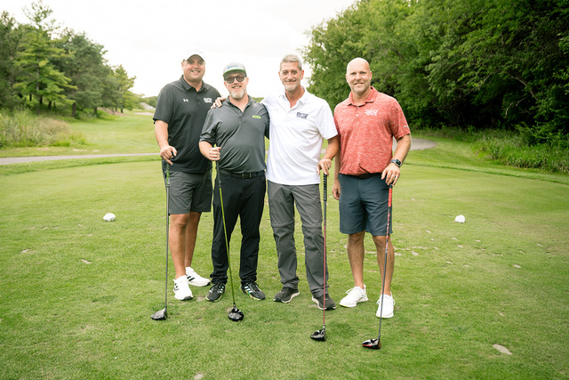
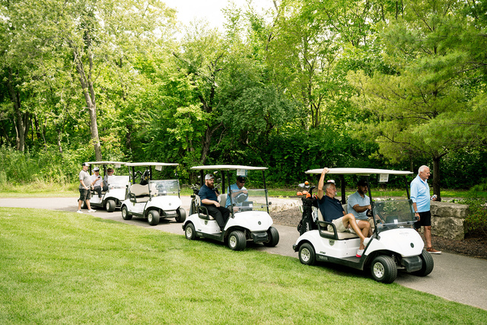
Tuesday, August 25, 2026
White Hawk Country Club
Crown Point, IN
11 a.m. CT Shotgun Start
Register today to reserve your spot! Foursomes sell out fast!

Slide 27
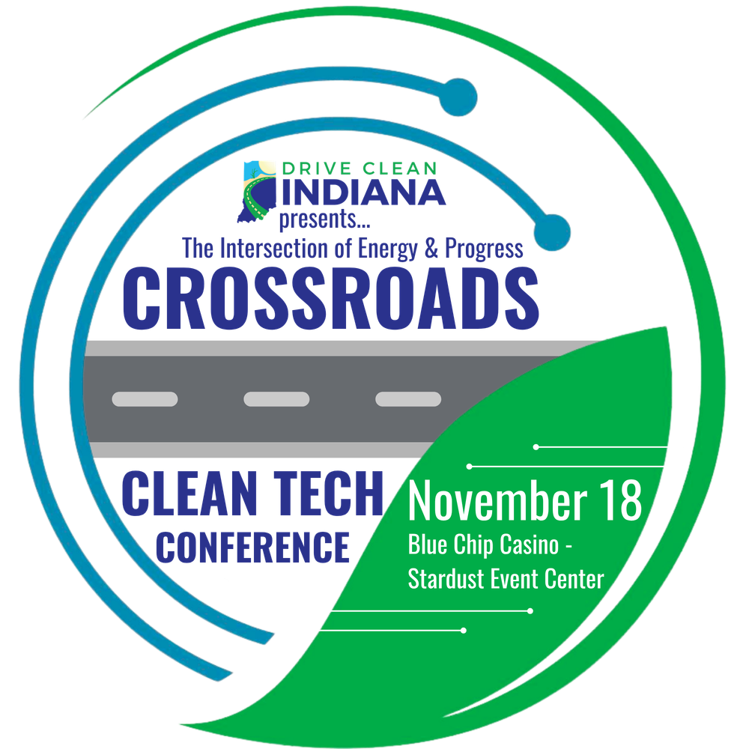
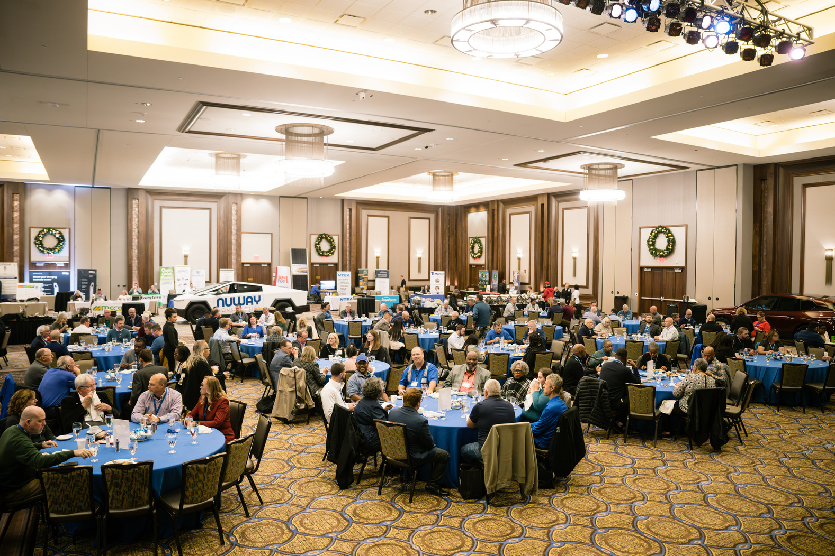
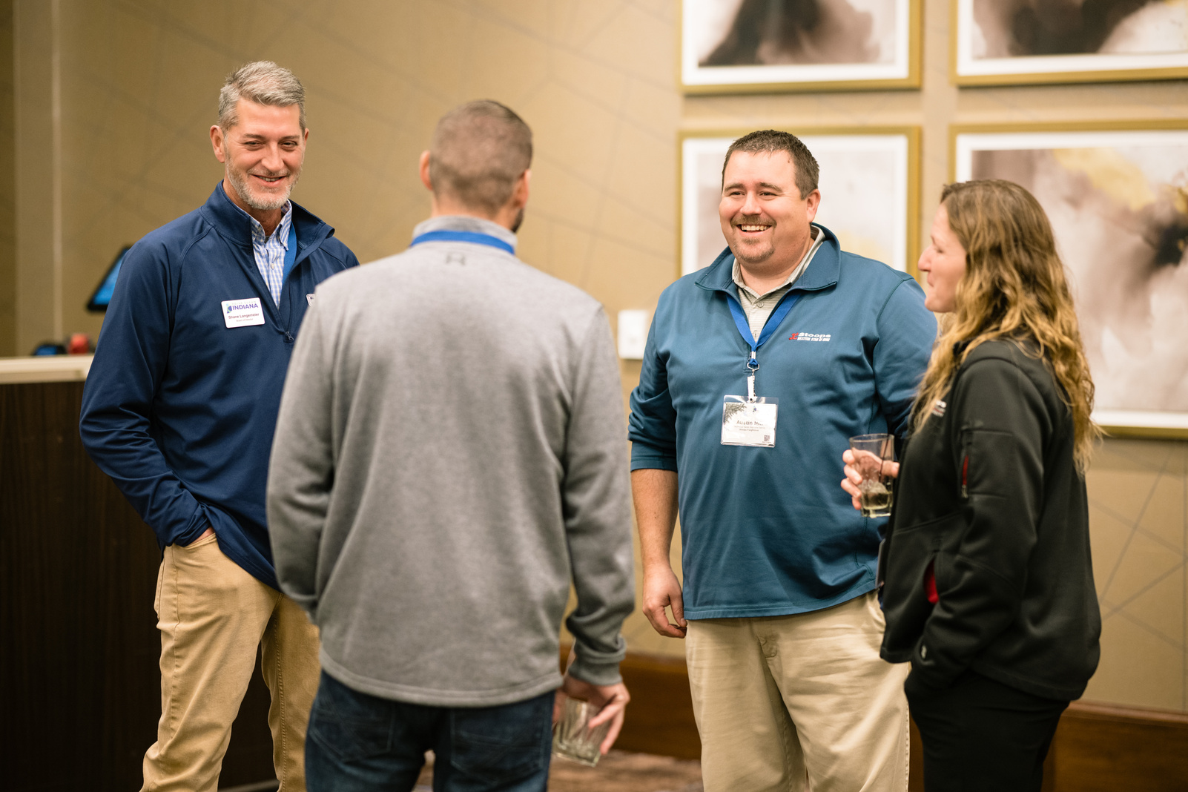
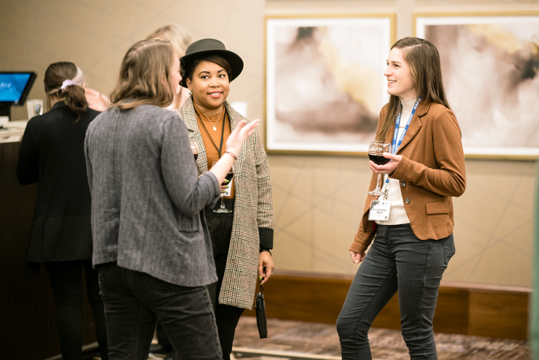
November 17-18, 2026
Blue Chip Casino’s Stardust Event Center
Michigan City, IN
Registration Coming Soon!

